Slide 1
Section 6.4
Logarithmic Functions
Copyright © 2012 Pearson Education, Inc. Publishing as Prentice Hall.

Slide 2
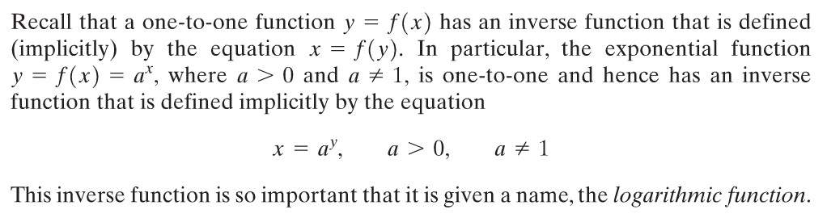
Copyright © 2012 Pearson Education, Inc. Publishing as Prentice Hall.

Slide 3

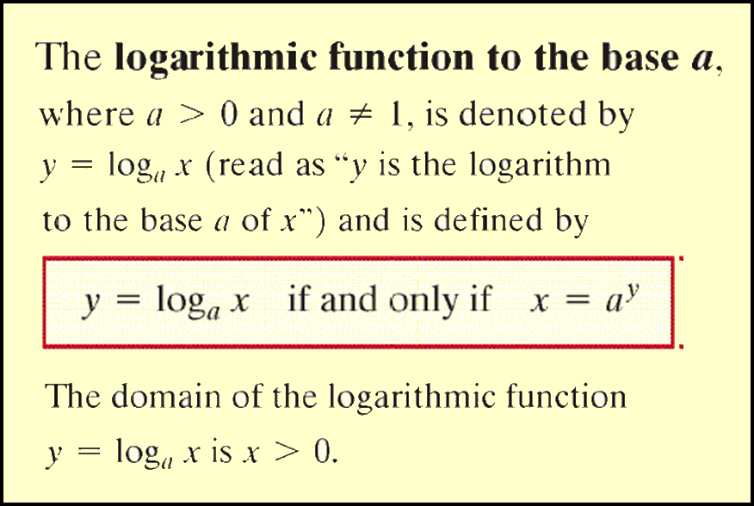
Copyright © 2012 Pearson Education, Inc. Publishing as Prentice Hall.

Slide 4

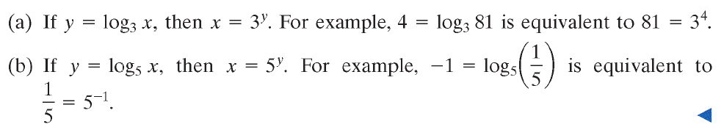
Copyright © 2012 Pearson Education, Inc. Publishing as Prentice Hall.

Slide 5
Copyright © 2012 Pearson Education, Inc. Publishing as Prentice Hall.

Slide 6
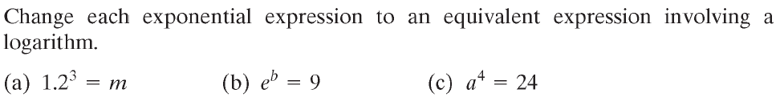




Copyright © 2012 Pearson Education, Inc. Publishing as Prentice Hall.

Slide 7
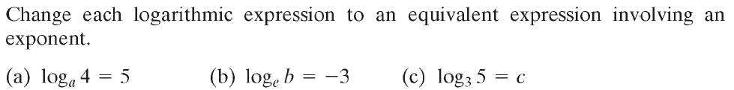



Copyright © 2012 Pearson Education, Inc. Publishing as Prentice Hall.

Slide 8
Copyright © 2012 Pearson Education, Inc. Publishing as Prentice Hall.

Slide 9
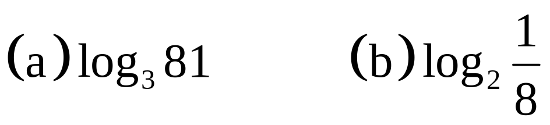
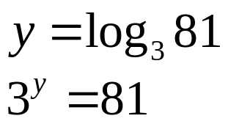
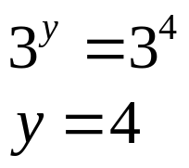
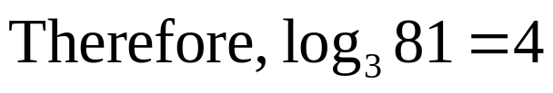
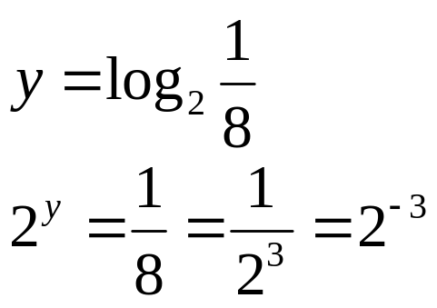

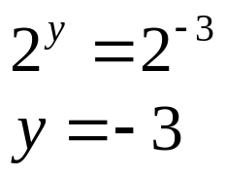
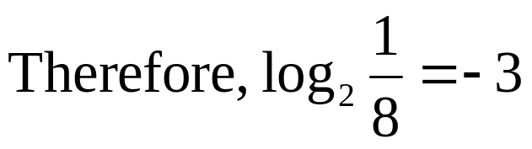
(a) 3 raised to what power yields 81?
(b) 2 raised to what power yields ?
Copyright © 2012 Pearson Education, Inc. Publishing as Prentice Hall.

Slide 10
Copyright © 2012 Pearson Education, Inc. Publishing as Prentice Hall.

Slide 11
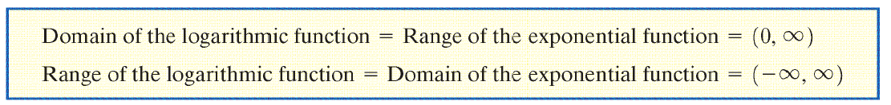

Copyright © 2012 Pearson Education, Inc. Publishing as Prentice Hall.

Slide 12
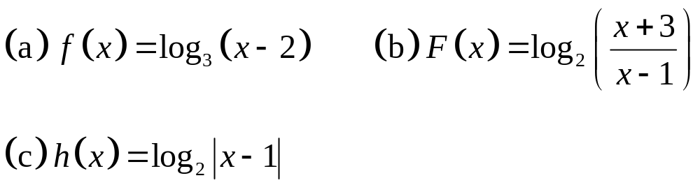
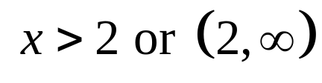
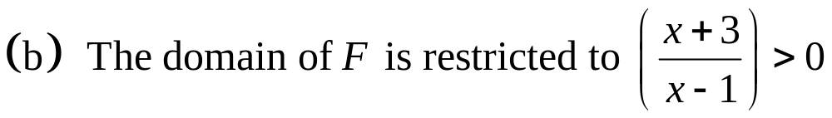
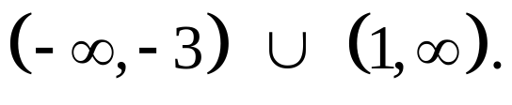
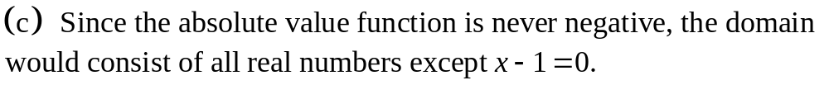
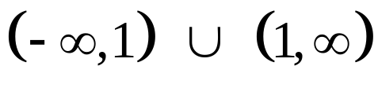
Copyright © 2012 Pearson Education, Inc. Publishing as Prentice Hall.

Slide 13

Copyright © 2012 Pearson Education, Inc. Publishing as Prentice Hall.

Slide 14
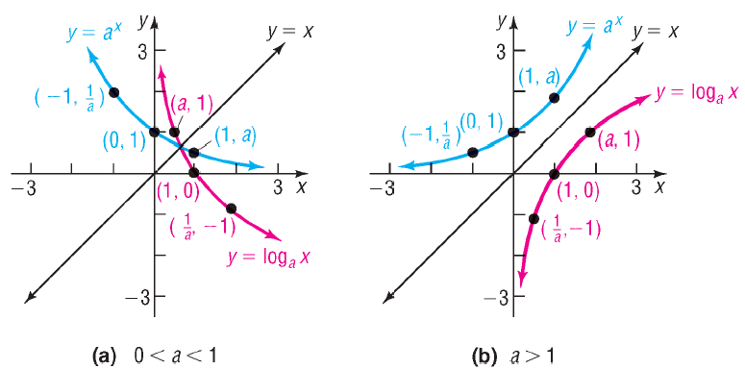
Copyright © 2012 Pearson Education, Inc. Publishing as Prentice Hall.

Slide 15
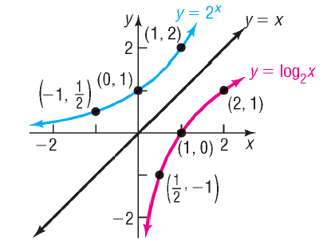
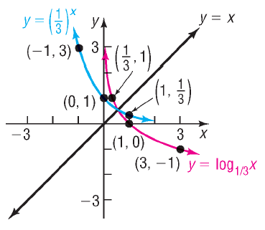
Copyright © 2012 Pearson Education, Inc. Publishing as Prentice Hall.

Slide 16
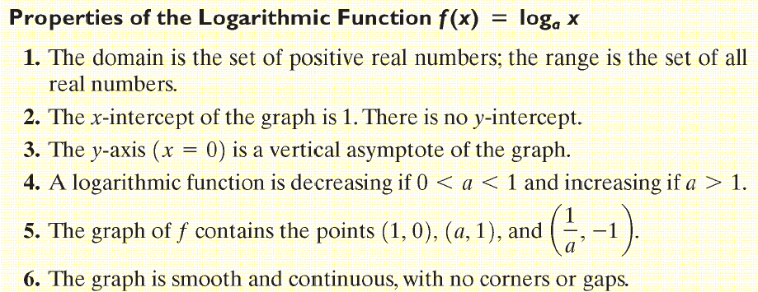
Copyright © 2012 Pearson Education, Inc. Publishing as Prentice Hall.

Slide 17
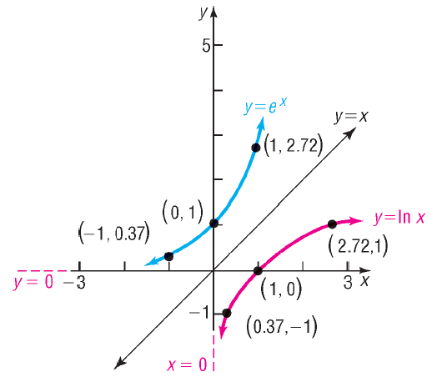
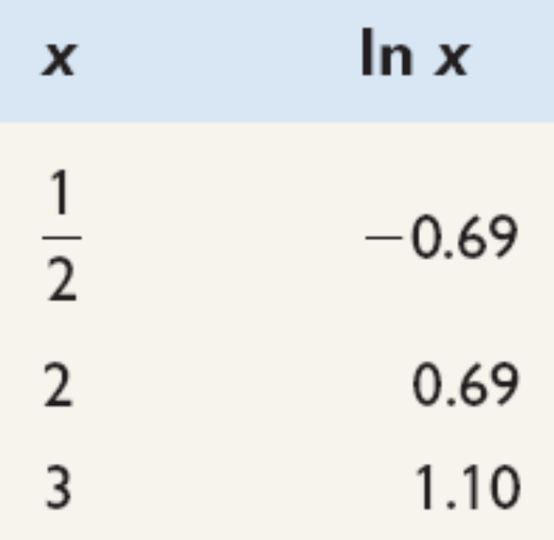

Natural Logarithm Function
Copyright © 2012 Pearson Education, Inc. Publishing as Prentice Hall.

Slide 18
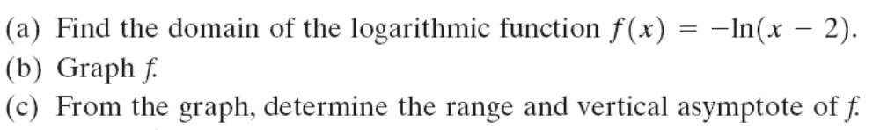
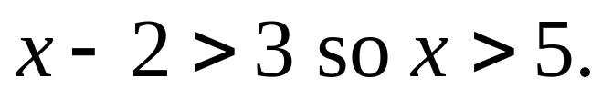
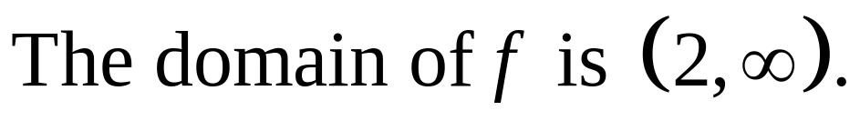
Copyright © 2012 Pearson Education, Inc. Publishing as Prentice Hall.

Slide 19
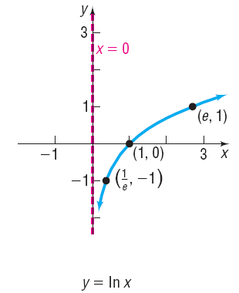
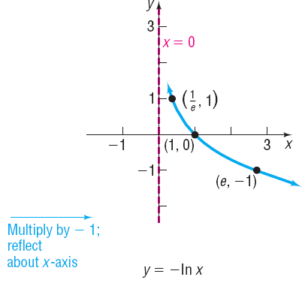
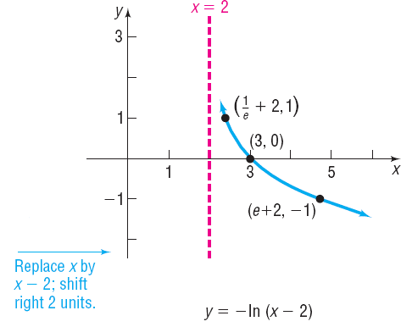
Copyright © 2012 Pearson Education, Inc. Publishing as Prentice Hall.

Slide 20
The range of f is all real numbers and the vertical asymptote is x = 2.
Copyright © 2012 Pearson Education, Inc. Publishing as Prentice Hall.

Slide 21
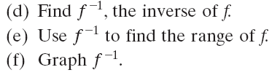
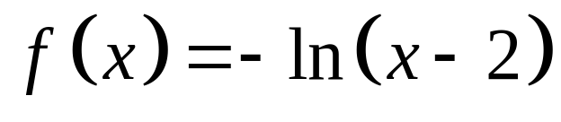
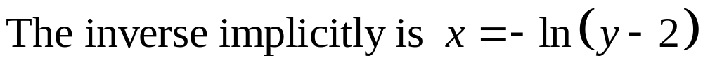
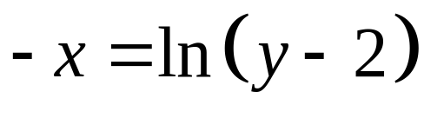
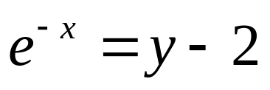
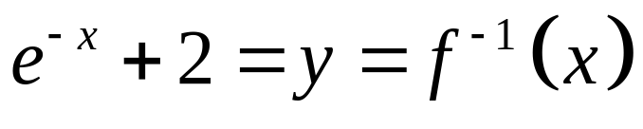
Copyright © 2012 Pearson Education, Inc. Publishing as Prentice Hall.

Slide 22
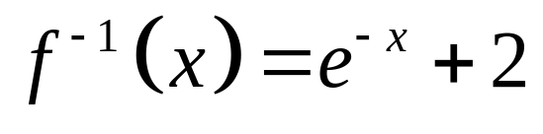
Since the range of f equals the domain of f ⁻¹, the range of f is all real numbers.
Copyright © 2012 Pearson Education, Inc. Publishing as Prentice Hall.

Slide 23
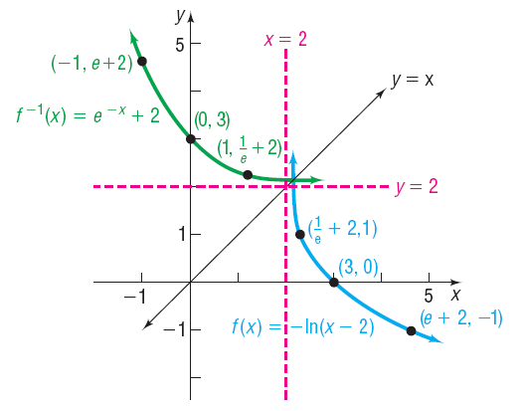
Copyright © 2012 Pearson Education, Inc. Publishing as Prentice Hall.

Slide 24

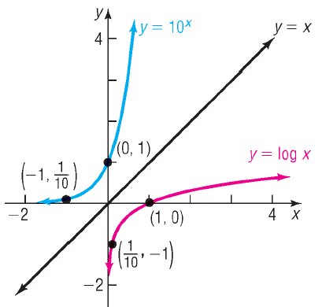
Common Logarithm Function
Copyright © 2012 Pearson Education, Inc. Publishing as Prentice Hall.

Slide 25
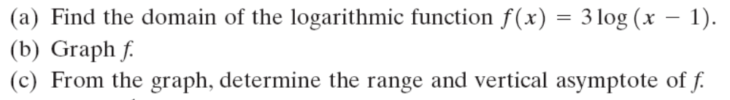
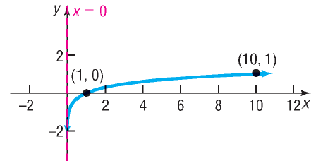
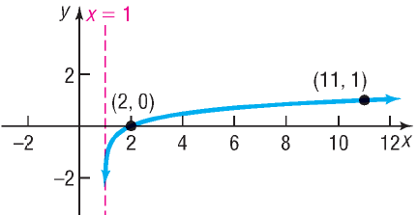

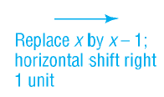
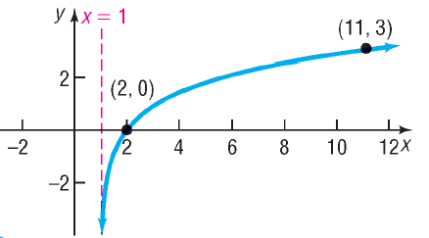


Copyright © 2012 Pearson Education, Inc. Publishing as Prentice Hall.

Slide 26
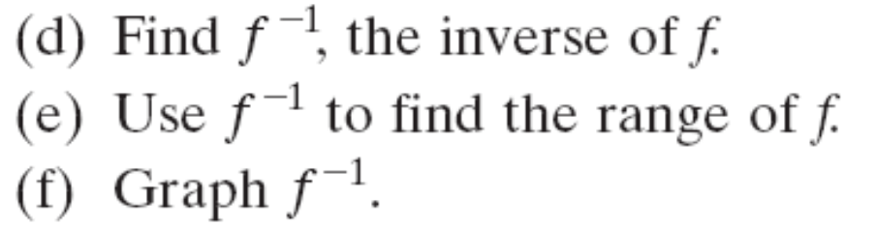
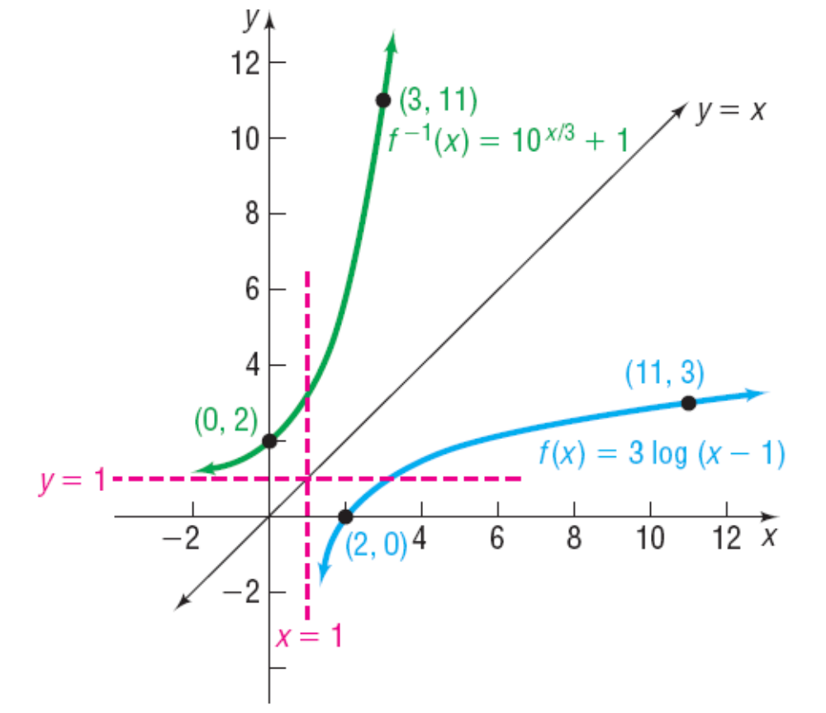
Copyright © 2012 Pearson Education, Inc. Publishing as Prentice Hall.

Slide 27
Copyright © 2012 Pearson Education, Inc. Publishing as Prentice Hall.

Slide 28
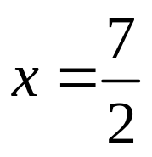


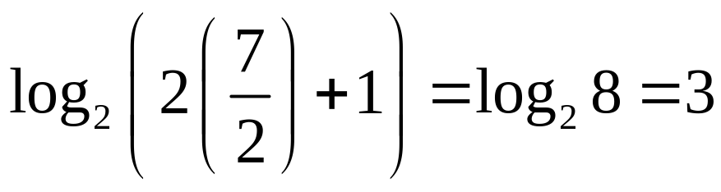



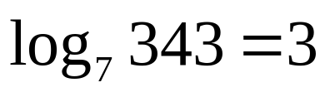
Copyright © 2012 Pearson Education, Inc. Publishing as Prentice Hall.

Slide 29





Isolate the exponential.
Change to logarithmic form.
Exact solution
Approximate solution
Copyright © 2012 Pearson Education, Inc. Publishing as Prentice Hall.

Slide 30





Copyright © 2012 Pearson Education, Inc. Publishing as Prentice Hall.

Slide 31


Copyright © 2012 Pearson Education, Inc. Publishing as Prentice Hall.

Slide 32



Copyright © 2012 Pearson Education, Inc. Publishing as Prentice Hall.

Slide 33




Copyright © 2012 Pearson Education, Inc. Publishing as Prentice Hall.

Slide 34


Copyright © 2012 Pearson Education, Inc. Publishing as Prentice Hall.

